Slide 1
2020 Census Enterprise Architecture and Infrastructure Transition Plan (CEAITP): Technical Architecture View
Junxiang Wang
May 1st, 2017

Slide 2
1. Standards 2. Current Architecture VS Target Architecture

Slide 3
Standards(1)
IT Infrastructure
IT infrastructure is a combination of tools and methods such as hardware and software to help to develop, deliver and test IT services.
Service Oriented Architecture (SOA)
Aim to
Decrease architecture complexity and increases the application integration more efficiently.
Provide the data and application APIs to systems, which are accessible throughout the enterprise.
Deliver applications faster with lower system integration costs.
Provide support for application services reuse and enable business functions to operate more efficiently.

Slide 4
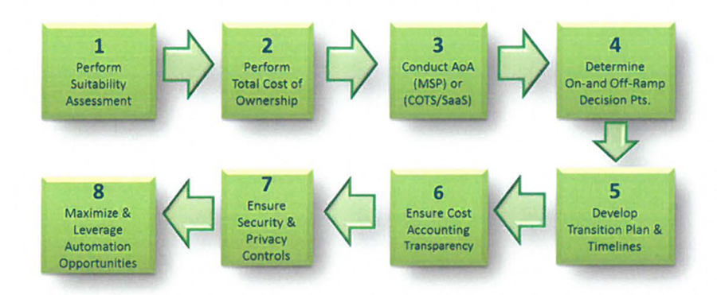
Standards(2)
Enterprise Cloud
Figure 1.Key Strategic Steps for Consideration to Enterprise Cloud

Slide 5
Standards(3)
Perform suitability assessment on technology/architecture to determine readiness or potential for a cloud solution.
Perform a Total Cost of Ownership (TCO) including an AoA to see if a commercial managed service provider (MSP) or COTS/Saas is more appropriate to deliver the capability.
Determine appropriate on-ramp and off-ramp, either in a tech refresh, or a move to a different cloud service provider (CSP), while considering alignment with other technologies that have dependencies or a specific application is dependent on.
Ensure appropriate security and privacy controls including records retention can be achieved with the solution.
Ensure cost accounting and transparency can be achieved with the solution. Consider what to purchase, how to monitor and control costs, and ensure appropriate levels of service(s) are provided for payments made.
Develop transition plan and schedule to include a WBS that aligns resources to the various activities.
Maximize and leverage automation opportunities- It is important to recognize possible areas and opportunities to automate and optimize technical and business operations.

Slide 6
Standards(4)
Program-Enterprise-System Quality
four categories of quality
Business/Program quality - Ensures governance processes, timelines, and milestones are realistic.
Enterprise quality - Ensures enterprise level services, integrations, and tools operate as designed and intended.
Data Quality- ensures the overall Census Count is accurate.
System Quality - ensures higher-quality data capture via entry by human or machine (e.g. scanning solution), or via interfacing with other internal and external systems.

Slide 7
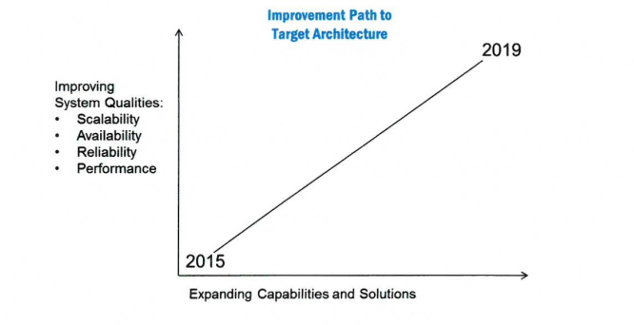
Standards(5)
Figure 2.Quality Aspects vs. Expanding Capabilities and Solutions
Figure 2.Quality Aspects vs. Expanding Capabilities and Solutions

Slide 8
Standards(6)
Scalability & Performance
Scalability refers to the ability of a system, network, or process to adapt and handle change in workload capacity and process demands.
The scale-up initiative is underway led by a three stage model, the conceptual, analysis, and implement/test.
The conceptualize stage starts the process by producing several artifacts. They are the demand models, and the Non-functional requirements.
The analysis stage realizes the overall solution, system, data flow, and interfaces.
The Implement/test focuses on execution and testing of the analyzed models, using optimization, partitioning, replication, design, patterns, scaling and continuous testing techniques.

Slide 9
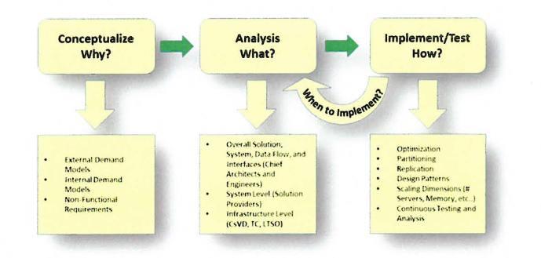
Standards(7)
Figure 3.2020 Scale-Up Three Stage Process

Slide 10
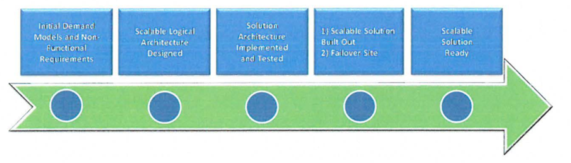
Standards(8)
Figure 4. Scale-up Initiative Transition Timeline

Slide 11
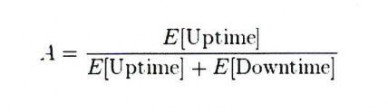
Standards(9)
Availability & Reliability
A system is considered reliable when it continues to operate as designed.
Availability is the probability that a system will work as required for the duration of its mission.
Figure 5. The definition of availability

Slide 12
Transition Approach(1)
Two standard approaches
The baseline first approach is used where an assessment of the baseline landscape is used to identify problem areas and improvement opportunities.
The target first approach is used where the target state solution is elaborated in detail and then mapped back to the baseline, in order to identify change activity.

Slide 13
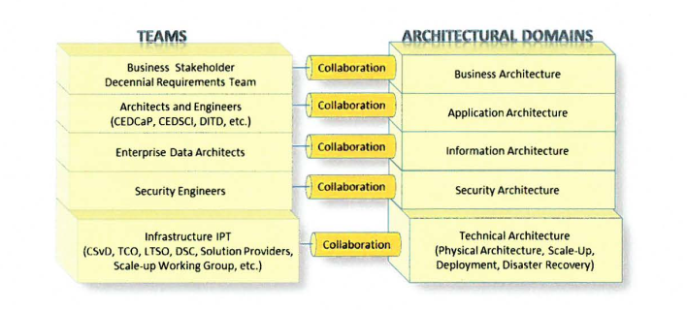
Transition Approach(2)
Architecture team teamed up with various teams and stakeholders to ensure a current state is precisely established.
Figure 6. Architectural Domains and Team Collaboration
Notes:
deleted

Slide 14
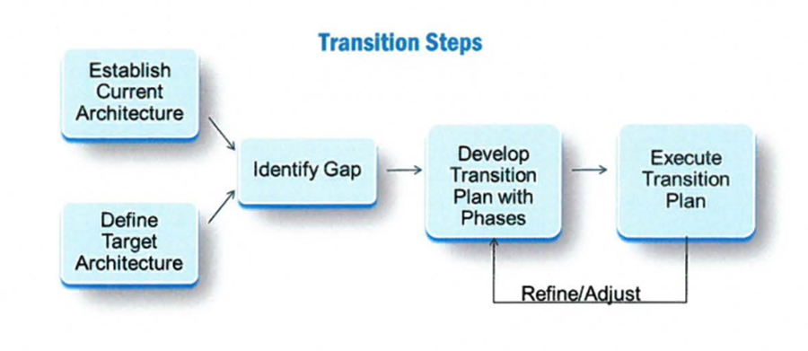
Transition Approach(3)
Transition Steps(similar to EAP model)
Figure 7. 2020 Census Architecture Transition Steps
Notes:
deleted

Slide 15
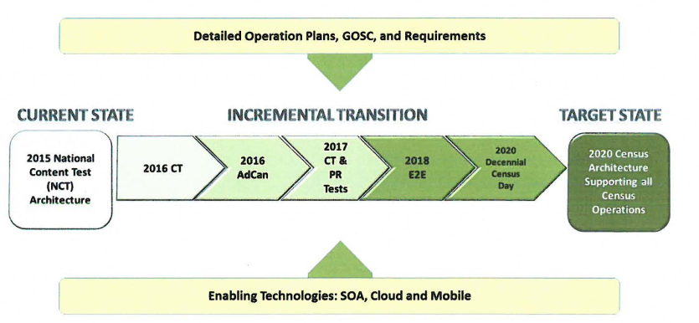
Transition Approach(4)
Phased Testing
Figure 8. 2020 Census Architecture Incremental Transition Model
Notes:
Mention touch point canvassing

Slide 16
Transition Approach(5)
Transition Tasks & Activities
Activity | Description
Finalize Target State Application Architecture | 1) Collaborate with Business Stakeholders and Business Requirements Team to analyze the Operations that are in the process of developing the Detailed Operational Plans, including requirements, Business Process Models, and Integrated Operation Diagrams. One venue is to participate in the IPT sessions. 2) Identify solutions that are needed for new capabilities, by leveraging existing systems, enhancing existing systems, or designing new systems, such as Island Areas, Coverage Measurement (CM), and Group Quarters (GQ), etc.
Disaster Recovery and COOP | Collaborate with the COOP Team to establish and analyze the COOP and ; Disaster Recovery requirements

Slide 17
Transition Approach(6)
Activity | Description
IT Infrastructure Support | a) Working Group established to design the IT Infrastructure, including Field offices, in order to support the 2020 Census Operations and systems in terms of capacity, scalability, reliability and system administration and monitoring. b) This effort will include the analysis and design of a failover site for Disaster Recovery and COOP. c) Ensure the readiness of IT Infrastructure by aligning the Census Test dates with the Technology Refresh phases.
Cloud Transition | Collaborate with Enterprise Services Framework Team and IT Divisions to establish a systematic plan to transition suitable systems that support 2020 Census to the Cloud environment.

Slide 18
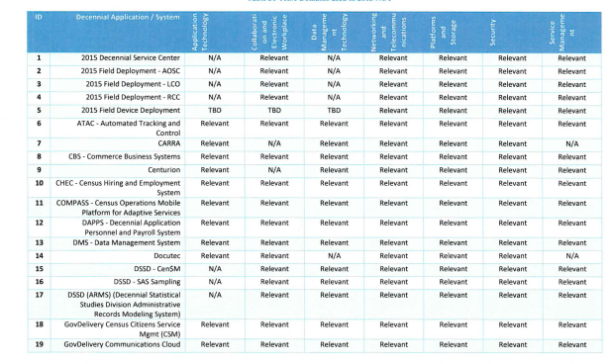
Current Architecture VS Target Architecture(1)
Infrastructure Architecture(Technical Reference Model)

Slide 19
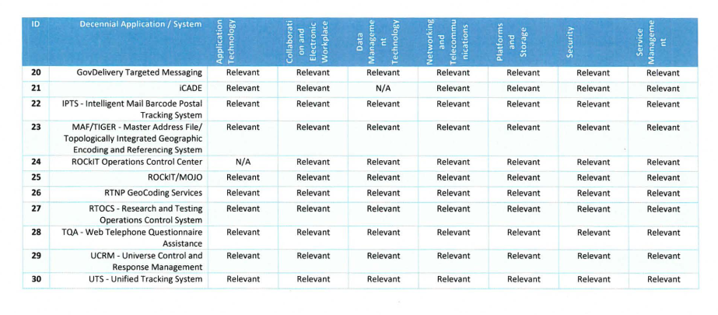
Current Architecture VS Target Architecture(2)
Figure 9. Technical reference model for the current infrastructure architecture

Slide 20
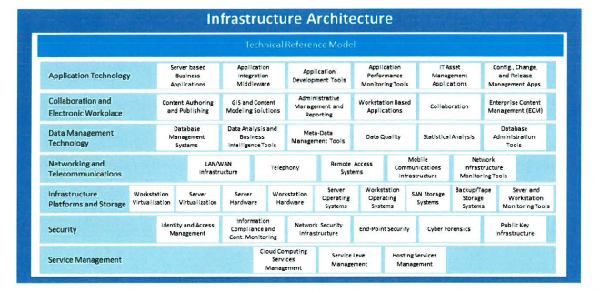
Current Architecture VS Target Architecture(3)
Figure 10. Technical reference model for the current infrastructure architecture

Slide 21
Current Architecture VS Target Architecture(4)
Security Architecture
Table 3. Standards and rules comparison
 | Current | Target
Standards and rules | Federal Information Security Management Act (FISMA) , the National Institute of Standards and Technology (NIST) ,Title 13 and Title 5 | Federal Information Security Management Act (FISMA) , the National Institute of Standards and Technology (NIST) , The Census Bureau Risk Management Framework (RMF),

Slide 22
Current Architecture VS Target Architecture(5)
Quality Architecture
Table 4. goal comparison
 | Current | Target
goals | Coverage Measurement was not a major focus while data quality is . | The primary goal of the 2020 Census is to collect complete, accurate, and quality Census data

Slide 23
Thank you.
Any questions?

